Slide 1
Newburgh Primary School

Slide 2
Newburgh Primary School Values
Nurturing
Engaged
Welcoming to everyone
Be considerate
Unique
Resilient
Great achievers
Happy and Healthy

Slide 3
The UK is surrounded by the sea, and our waters provide the habitat for over 44,000 different species of sea life.

Slide 4
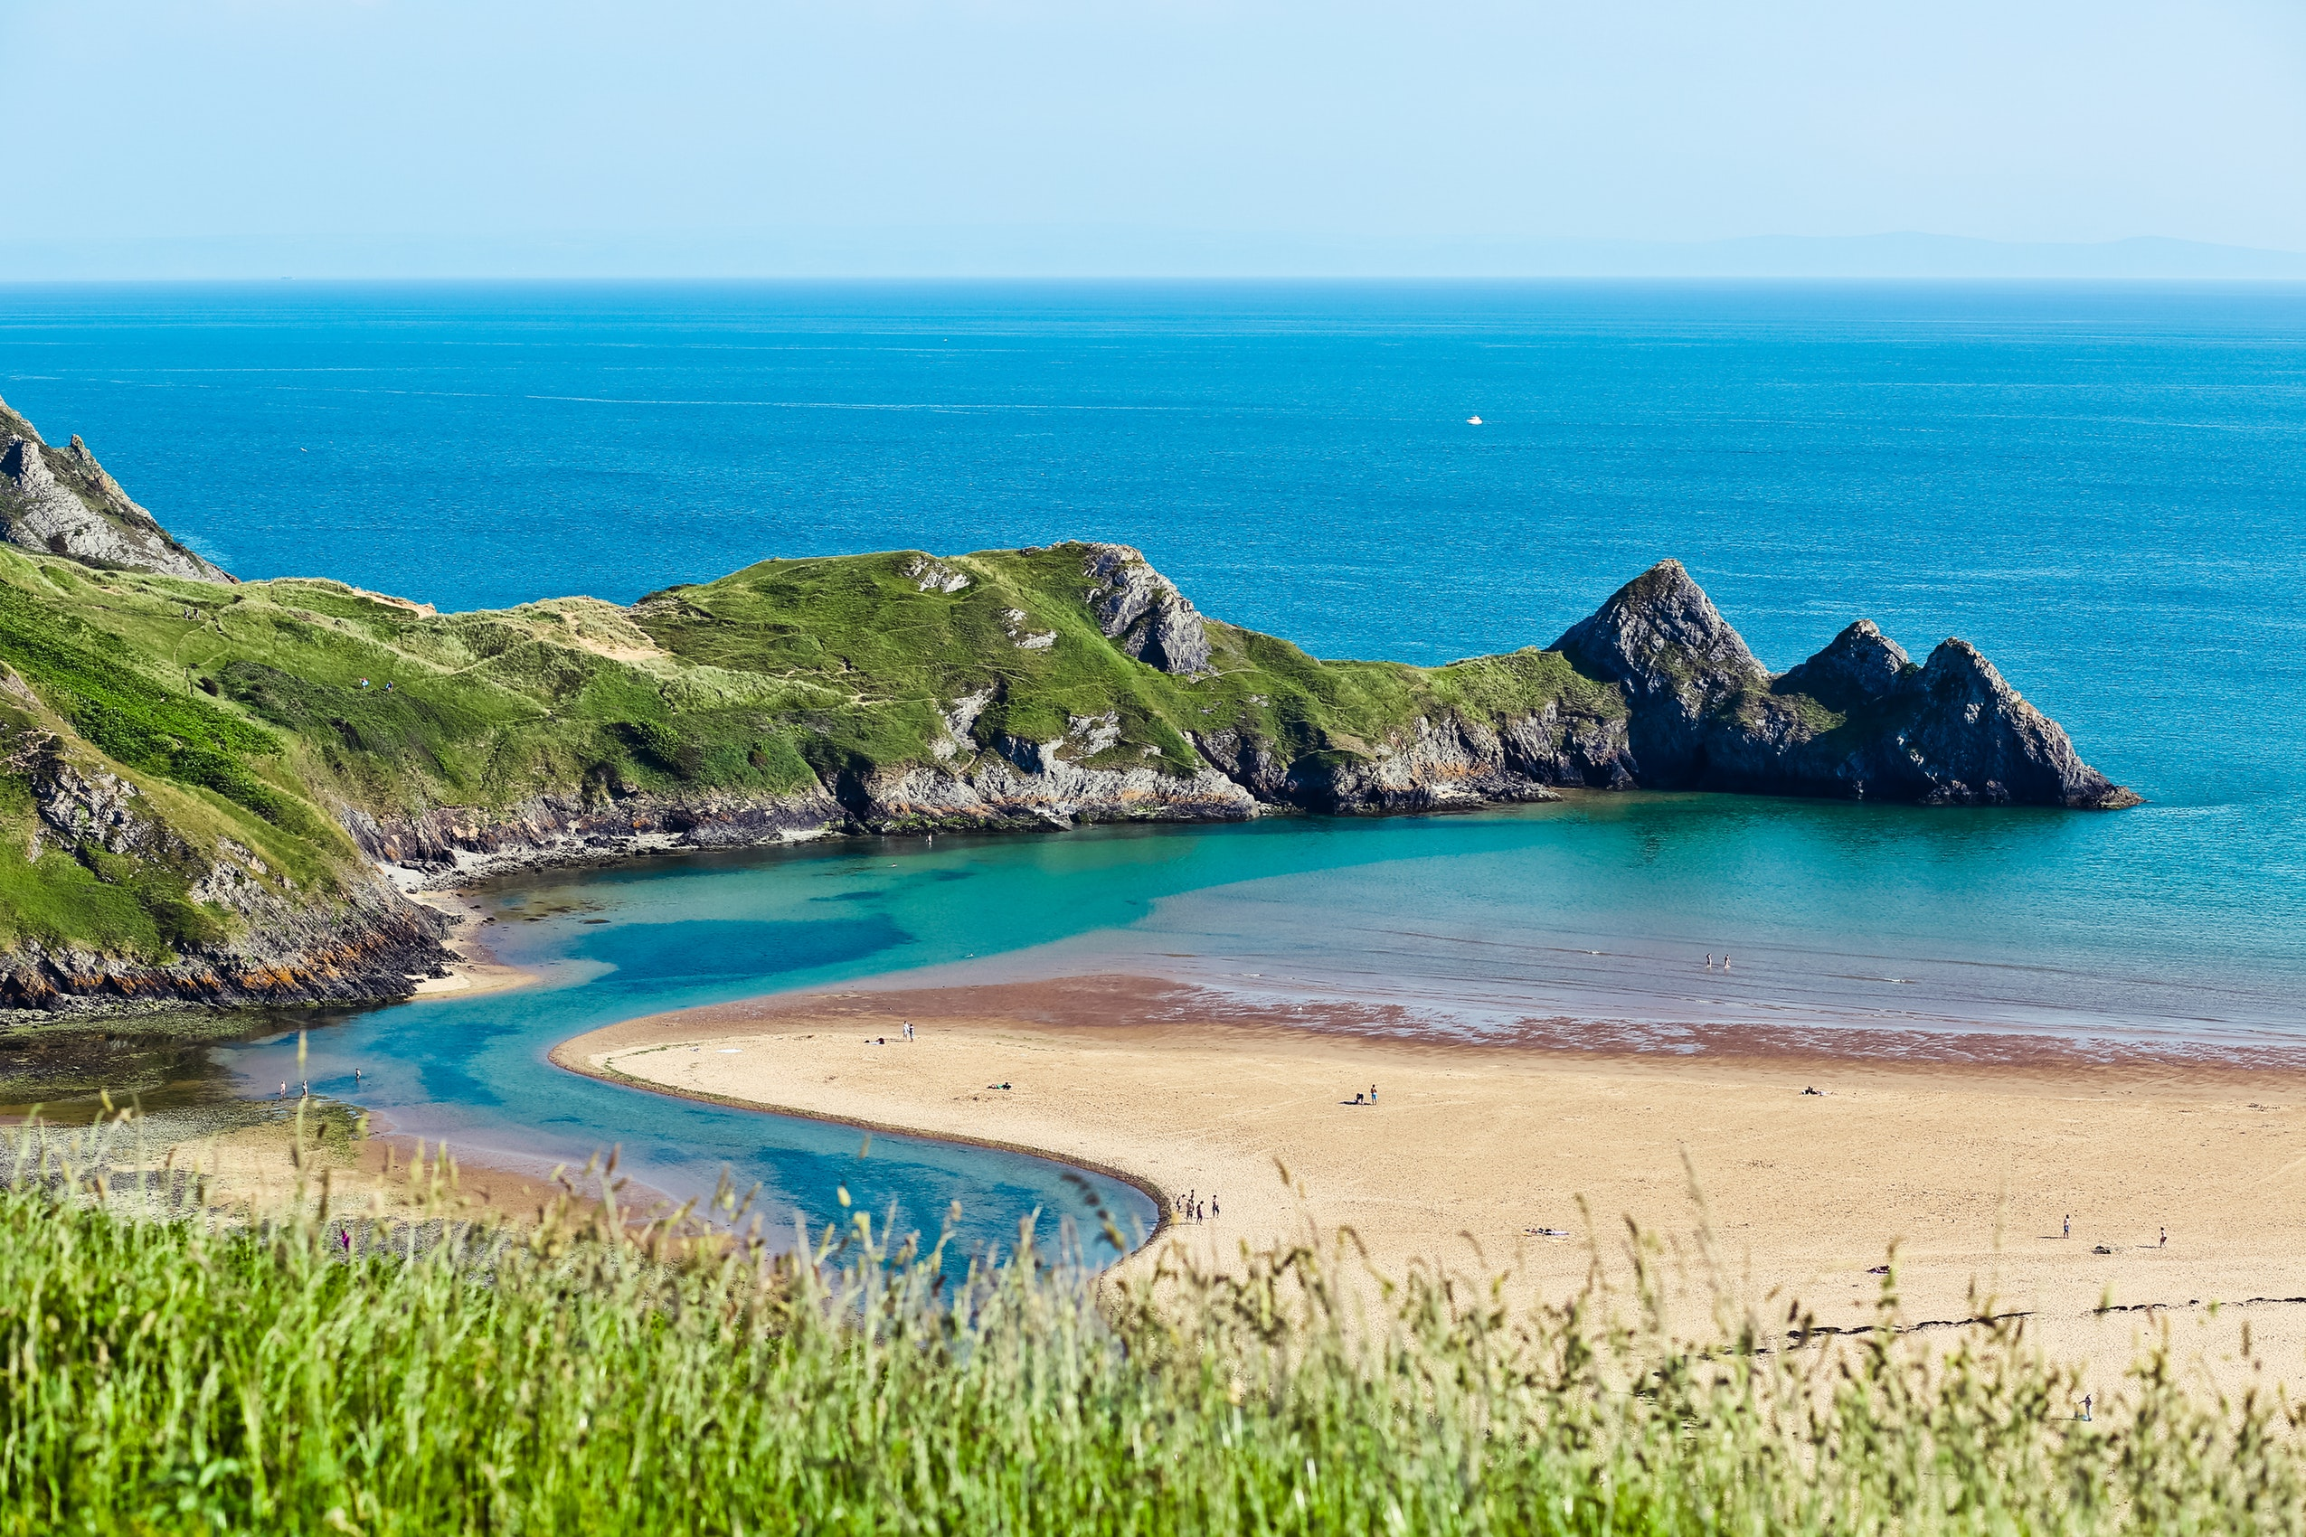

Slide 5
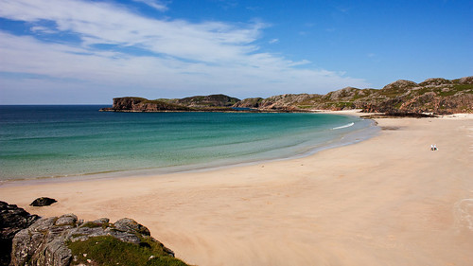

Slide 6
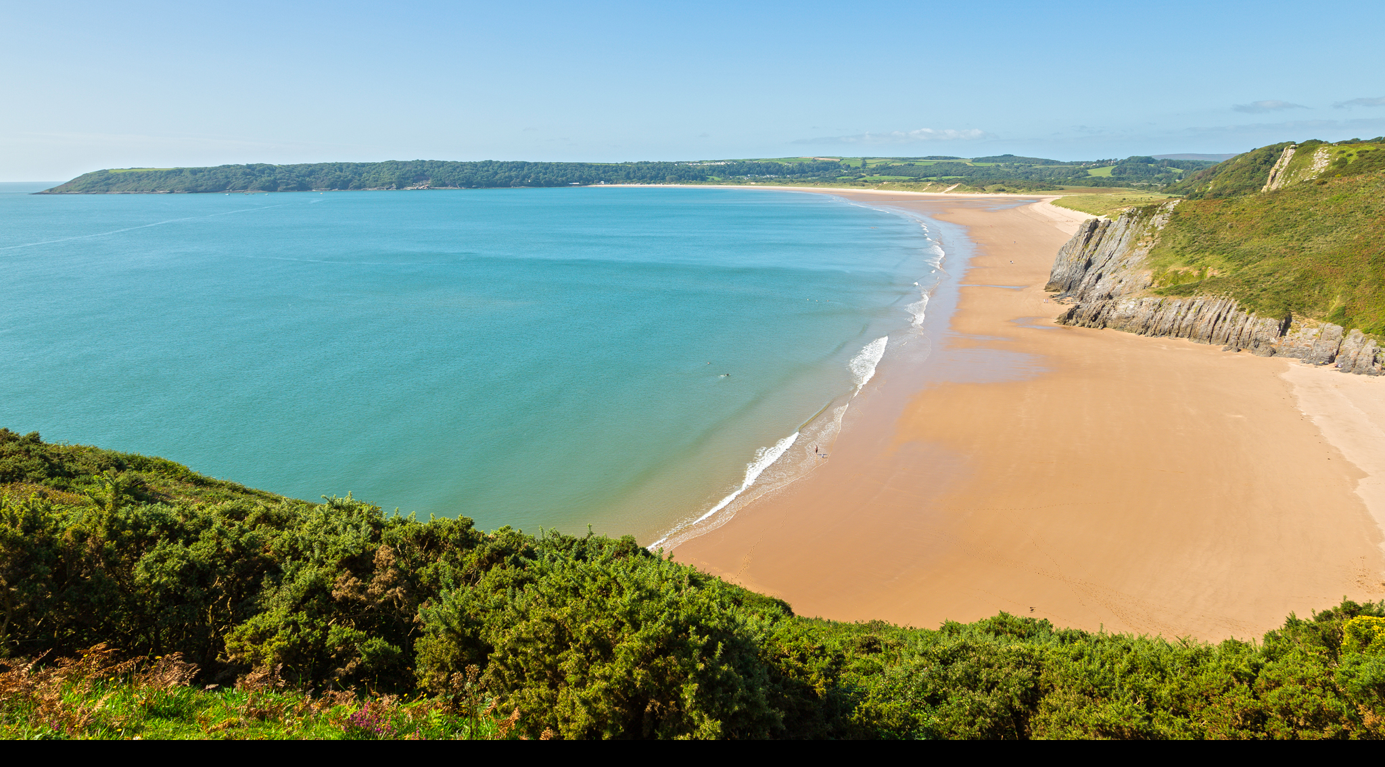

Slide 7
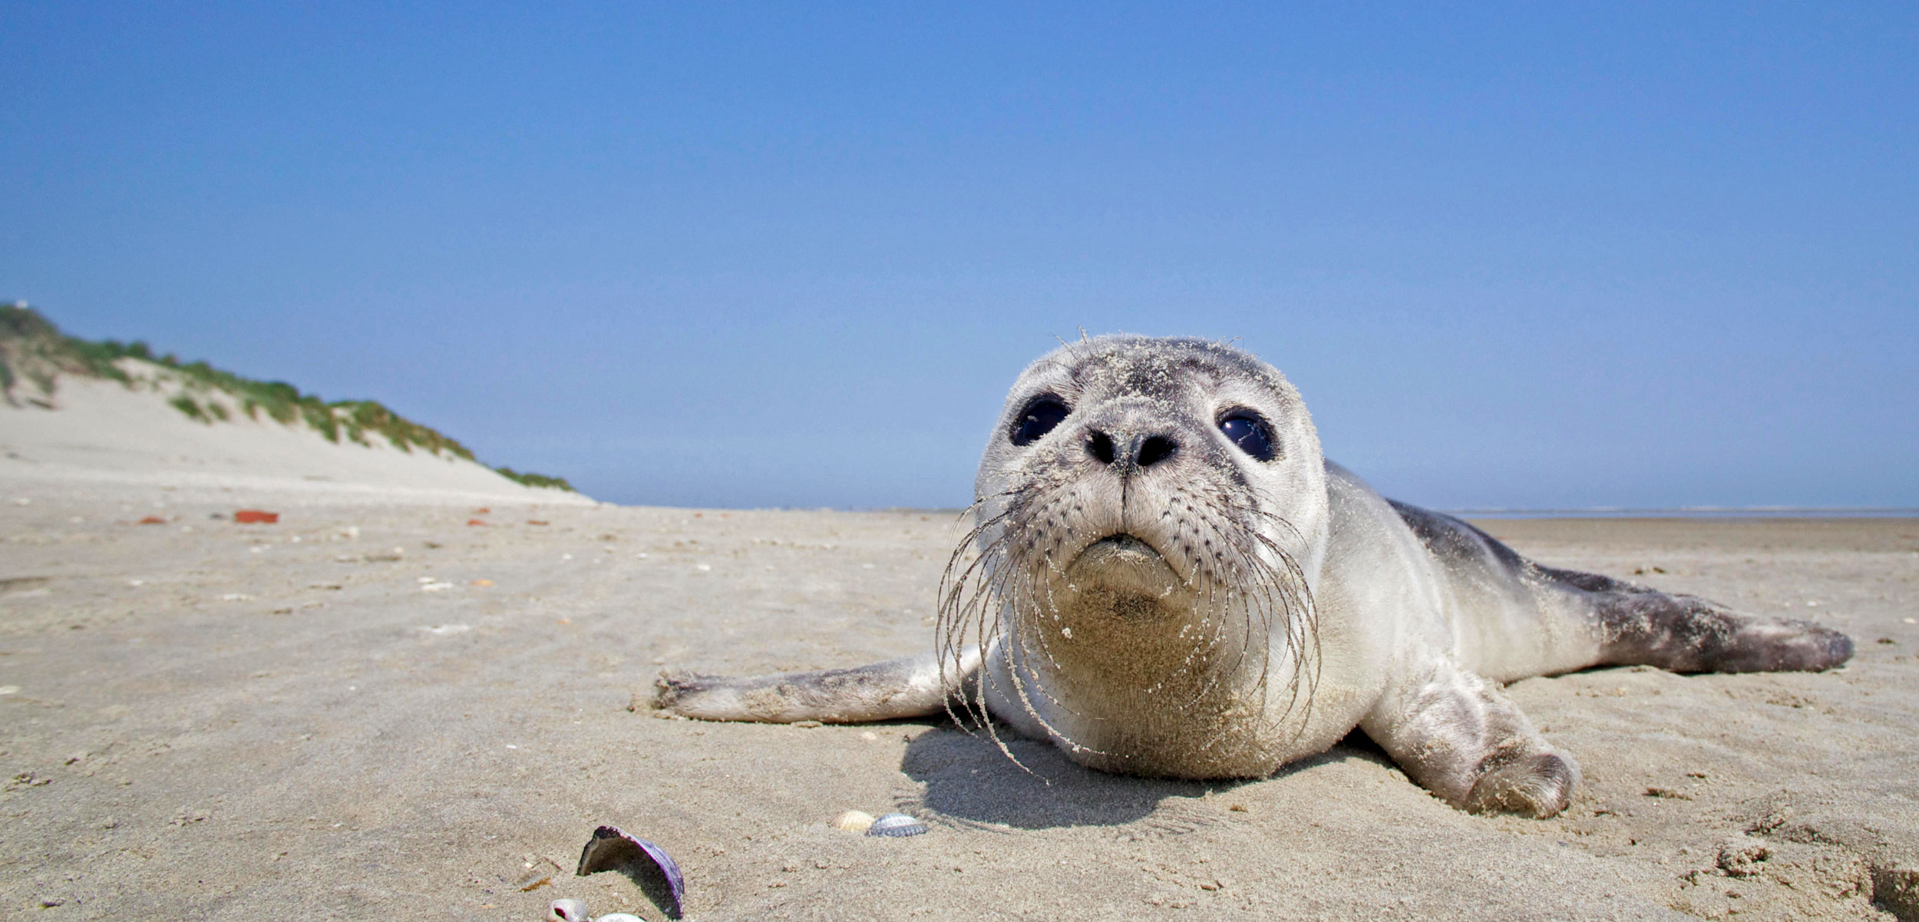

Slide 8
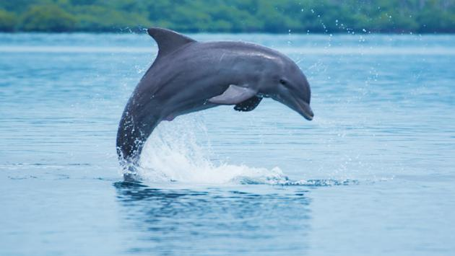

Slide 9
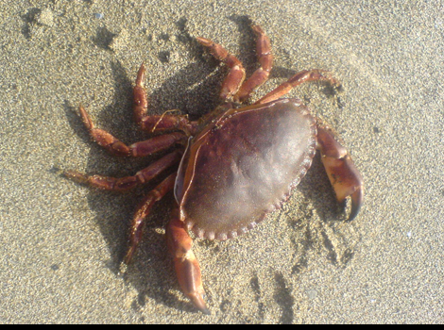

Slide 10
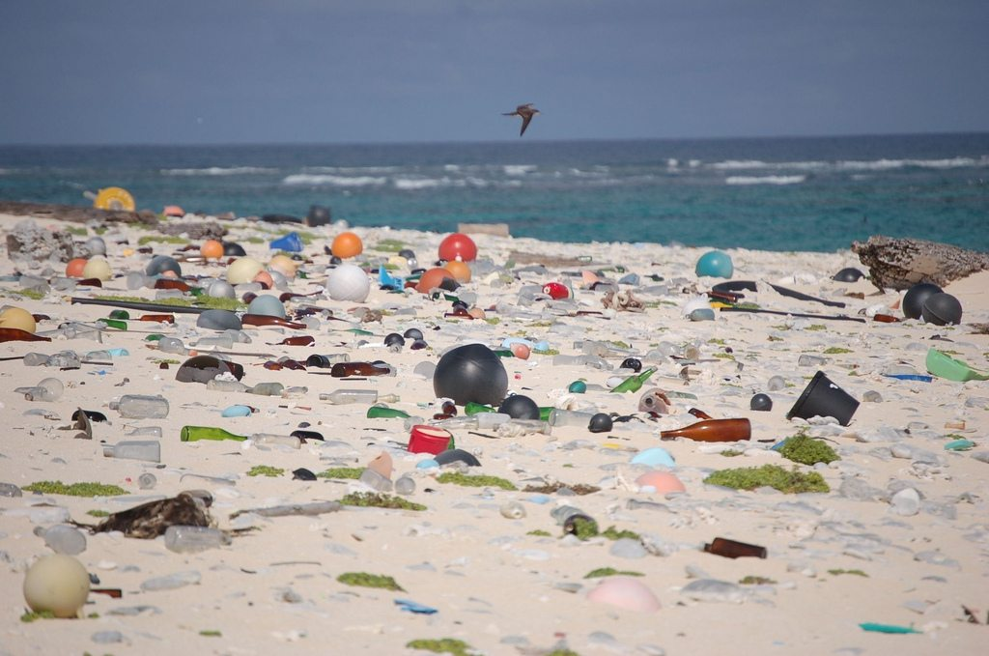

Slide 11
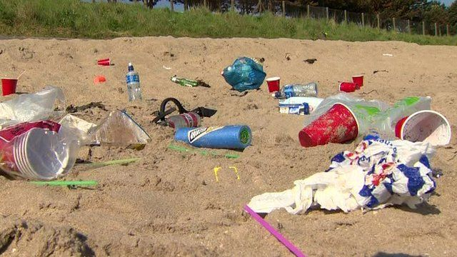

Slide 12
https://youtu.be/FDQb6sAPxMs

Slide 13
https://www.youtube.com/watch?v=9pRhgZ8Jffs

Slide 14
Marine scientists have discovered that many plastics that find their way into the world’s oceans are toxic. This means that these plastics can damage the animals and even kill them. Another problem is that wildlife such as seabirds can get entangled in bits of plastic or even become stuck in plastic bottles.

Slide 15
Fortunately, scientists, marine conservation societies and the UK government agree that we need to do more to protect our seas and oceans, particularly where the use of plastic is concerned. They suggest that we can all take some action – even if it is something as simple as taking home our rubbish after a day at the beach.
Here are some other suggestions that would help to reduce plastic pollution in the oceans.
- Invest in a reusable water bottle rather than relying on single-use ones.
- Take a bag with you when you go to the shops, rather than paying for single-use plastic ones.
- Look for alternatives to plastic containers.

Slide 16
Time for reflection
Many world faiths believe that we all have a responsibility to look after the world in which we live.
Christians believe that God made the world and wants us all to care for it: this is known as stewardship.
The Bible says, ‘The earth is the Lord’s and everything in it . . . for he founded it on the seas and established it on the waters.’ Christians believe that this means that we have no right to abuse God’s creation. Instead, we should act responsibly, realizing that we are privileged to have such a wonderful place in which to live.

Slide 17
Thank you for the beautiful world in which we live.
Thank you for the amazing variety of animals and plants.
Thank you for the sea and the beaches.
Please help us to think carefully about our responsibility in the world.
Please help us to care for the environment.
Please help us to think before we act.

